Slide 1
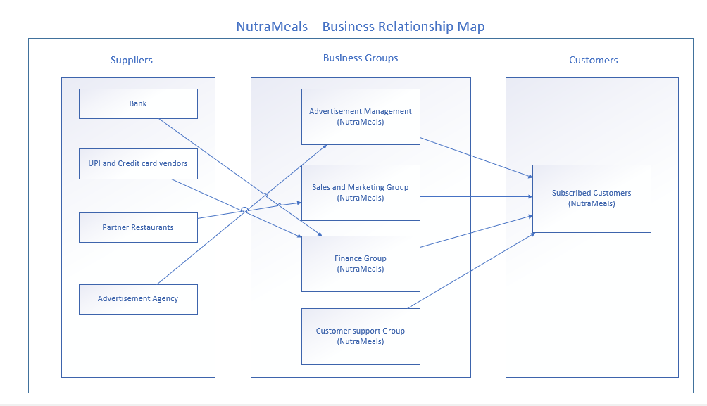
BRM Diagram

Slide 2
User Roles by Business Group
External Users (Customers)
Subscribed Customers
Internal Users
Business Group | User Roles | Team Member Name (Bus. Group Proxy)
Advertisement Management | Advertisement Representative Food popularity trend Analyst | Divya Kotapati
Sales and Marketing Group | Area Sales Manager Sales broker | Sen Wang
Finance Group | Accountant | Daksh Rawat
Customer Support Group | Customer care representative Supervisor | Nikita Jarile

